Slide 1


Case Study: Change Detection in Remote Sensing

Slide 2
Outline
General schematic diagram of Change Detection
Change Detection methods
Datasets
Performance metrics
Separated and coupled Deep Learning Neural Network
Deep Learning architectures for Change Detection
References

Slide 3
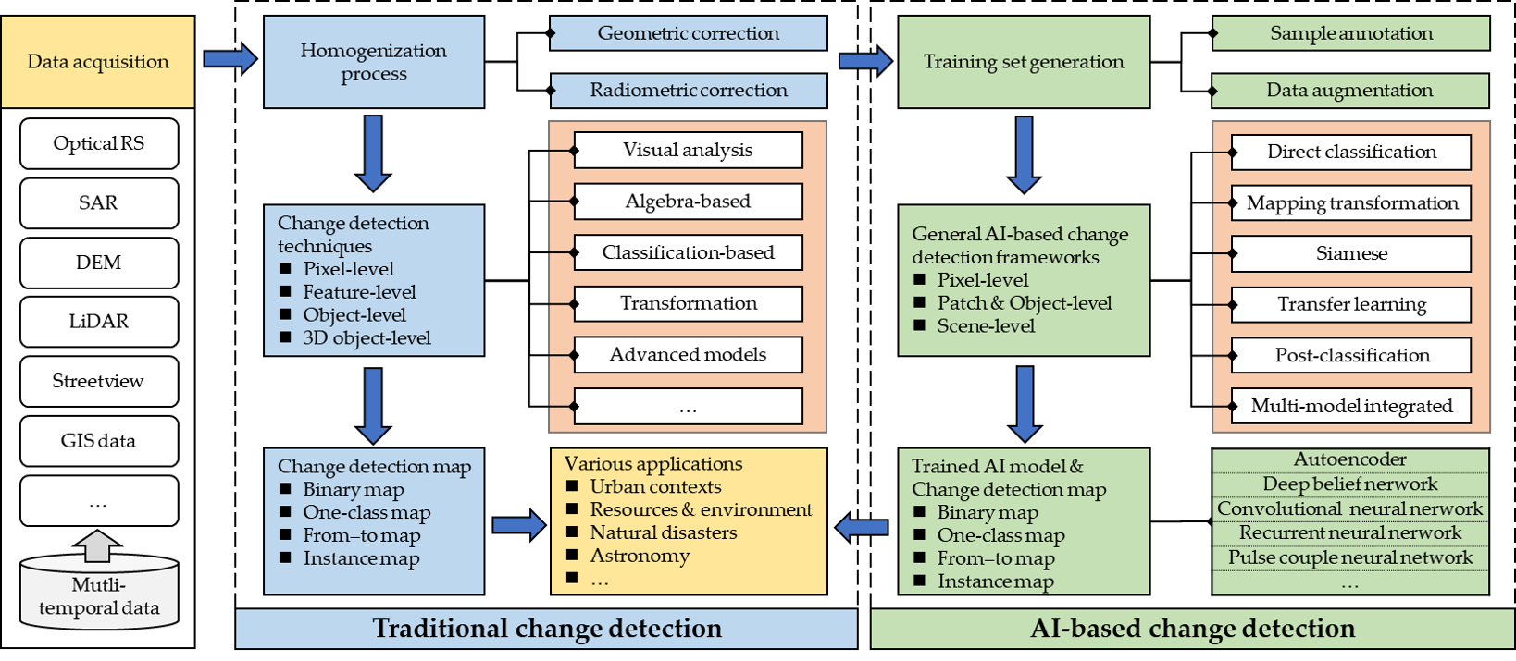
General schematic diagram of change detection^{[1]}

Slide 4
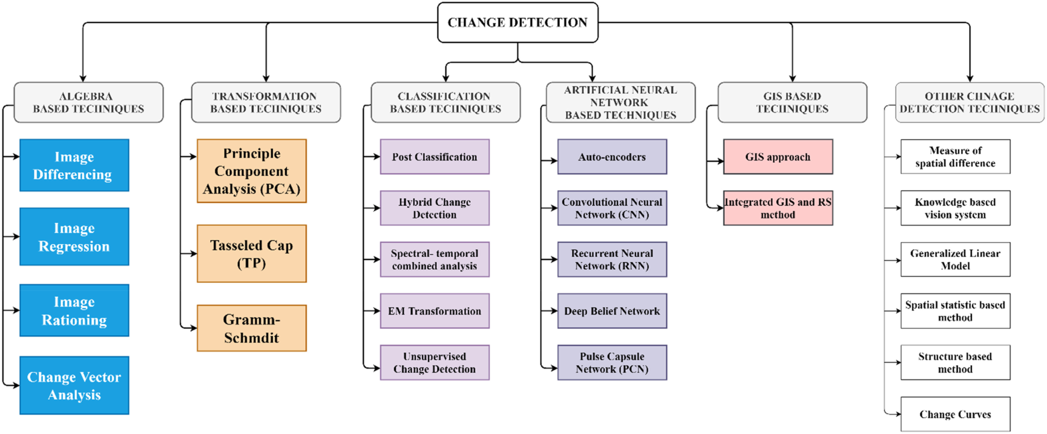
Change detection methods ^{[2]}

Slide 5
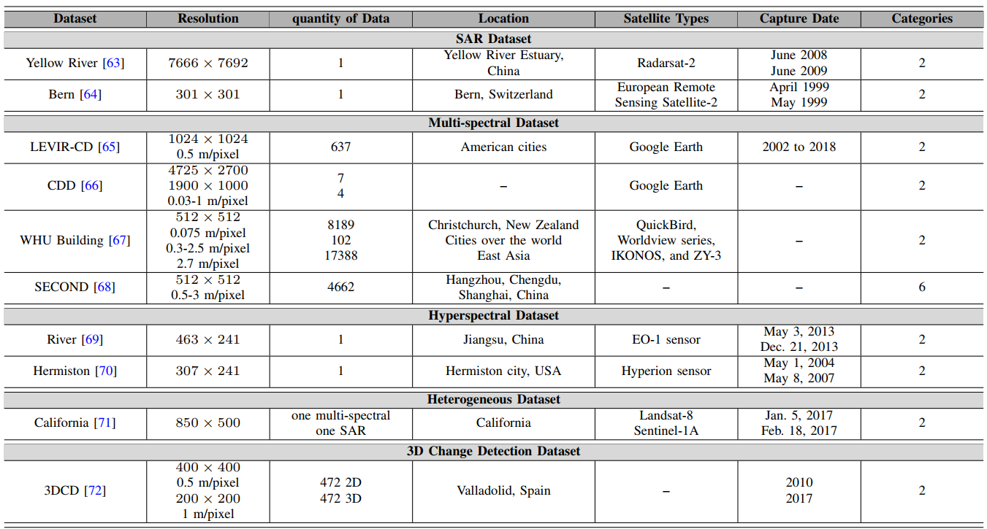
Datasets for Change Detection ^{[3]}

Slide 6
Performance metrics
Overall accuracy (OA)
Intersection over Union (IoU)
Precision, Recall
F1-score: harmonic average of precision and recall
Kappa coefficient (KC)
3D change detection: RMSE (Root Mean Squared Error) and cRMSE (Changed Root Mean Squared Error)
Semantic change detection (SCD): mean Intersection over Union (mIoU), Separated Kappa (Sek), SCD-targeted F1 Score (Fscd)
Loss function (Siamese network): Contrastive Loss, Triplet Loss

Slide 7
Why Deep learning for change detection?
DLCD has more powerful capability to represent the four types of information i.e. spectral, spatial, temporal, and multi-source information compared to the conventional change detection methods.
Deep learning feature extraction techniques
Convolutional Neural Networks (CNNs)
Auto-encoders (AE)
Attention mechanism and Transformers
Generative Adversarial Networks (GANs), Diffusion Model
Recurrent Neural Networks (RNNs)
Feature Pyramid Networks (FPN), Spatial Pyramid Pooling (SPP)

Slide 8
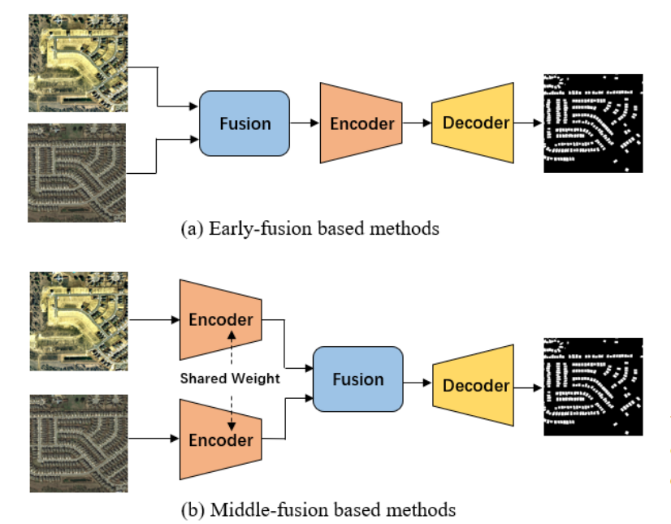
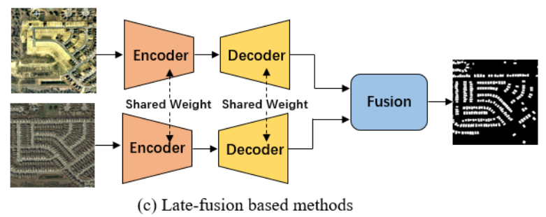
Classification of CD methods based on position of Fusion module ^{[3]}

Slide 9
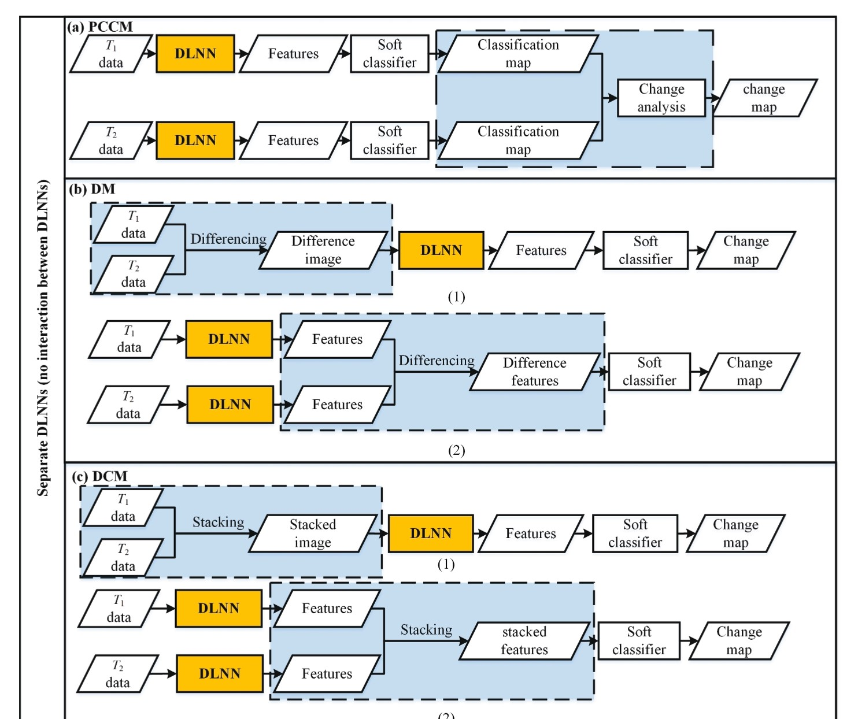
Separated DLNN ^{[4]} (a) Post-classification change method (PCCM). (b) Differencing method (DM). (c) Direct classification method (DCM).

Slide 10
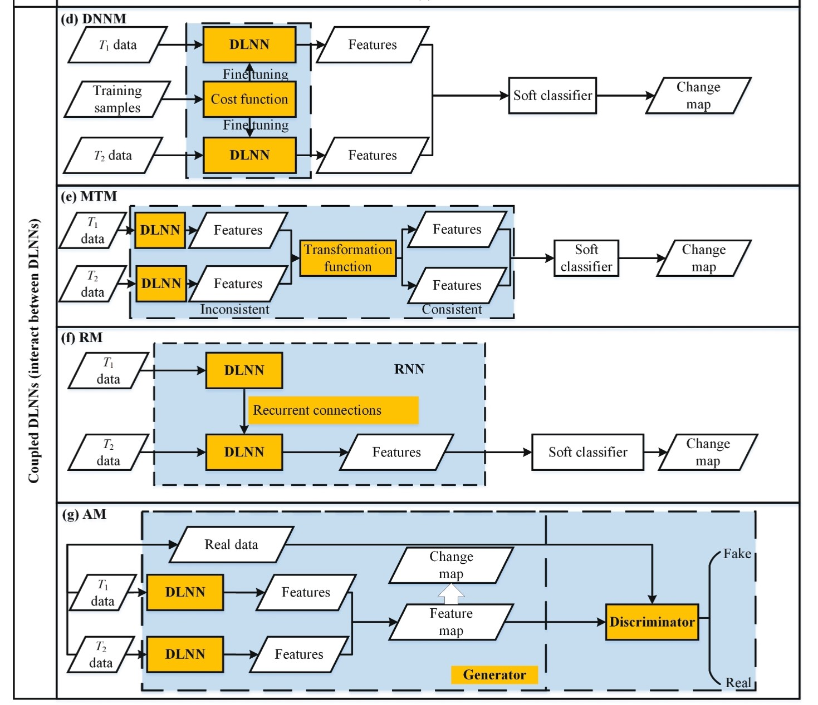
Coupled DLNN ^{[4]} (d) Differencing neural network method (DNNM). (e) Mapping transformation method (MTM). (f) Recurrent method (RM). (g) Adversarial method (AM).

Slide 11
DL architectures for CD

Slide 12
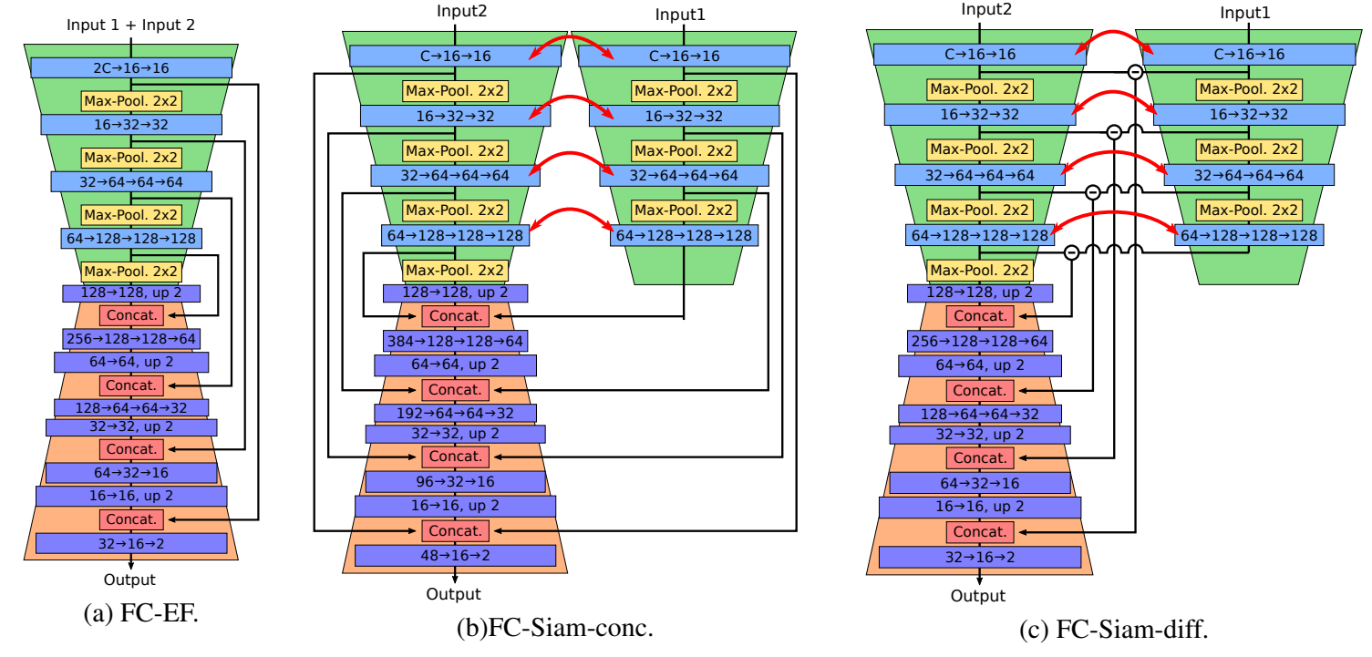
FULLY CONVOLUTIONAL SIAMESE NETWORKS FOR Binary CD ^{[5]}

Slide 13
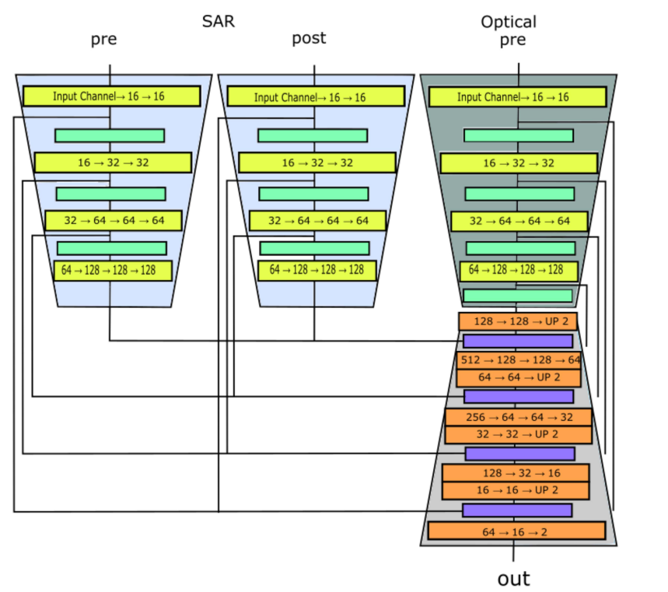
Supervised Change Detection Using
Prechange Optical-SAR and Postchange SAR Data ^{[6]}

Slide 14
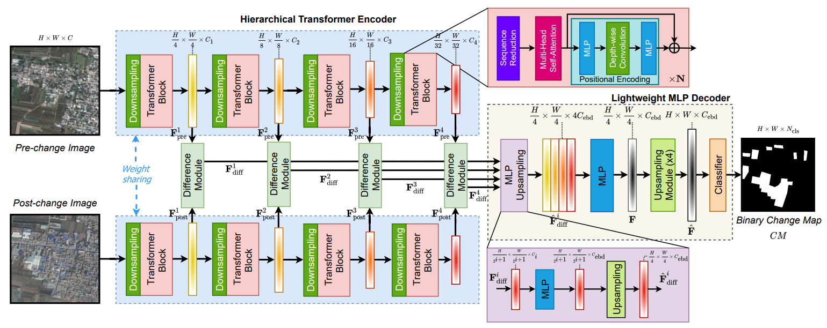
A TRANSFORMER-BASED SIAMESE NETWORK FOR CD ^{[7]}

Slide 15
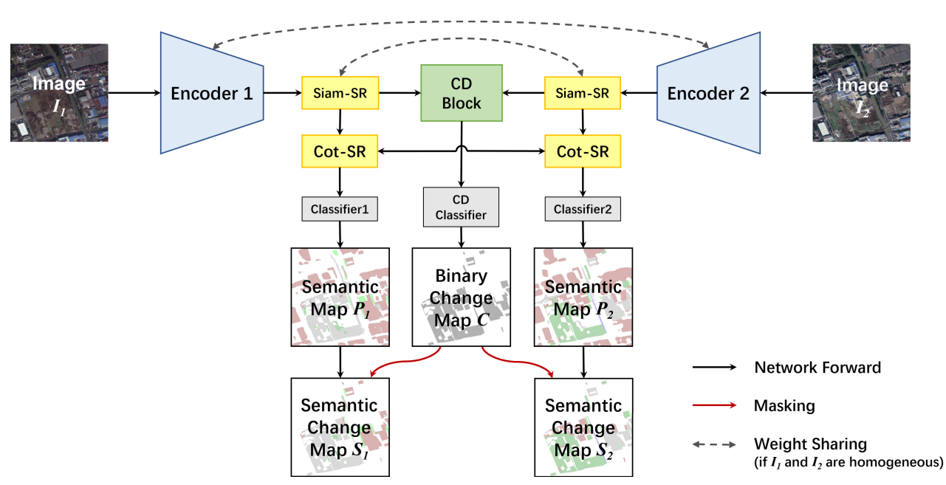
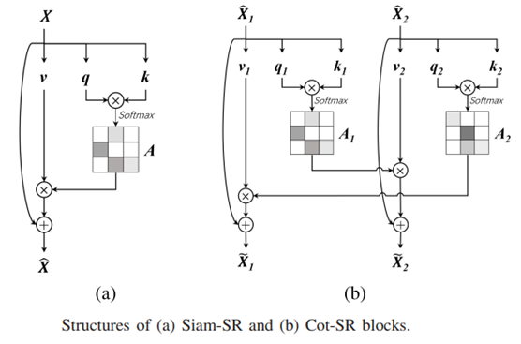
Bi-Temporal Semantic Reasoning for the Semantic Change Detection in HR Remote Sensing Images: Bi-SRNet for SCD ^{[8]}
Siamese semantic reasoning (Siam-SR),
cross-temporal SR (Cot-SR)

Slide 16
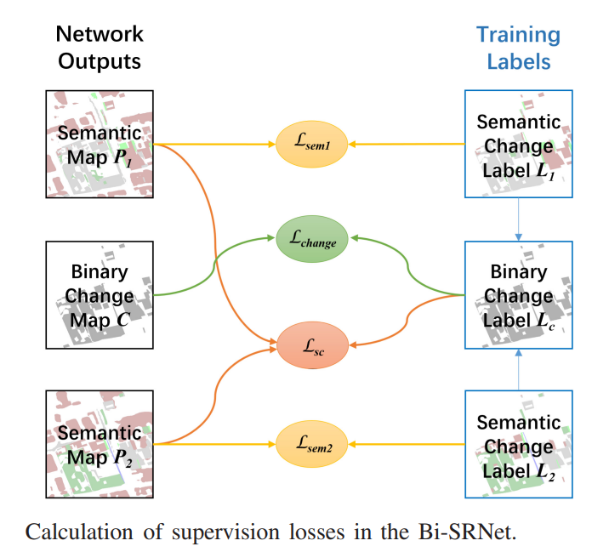
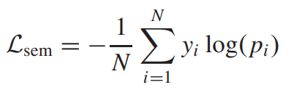
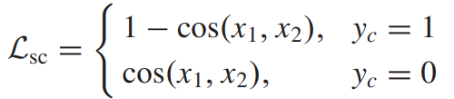
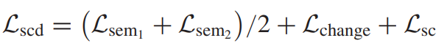
Loss function Calculation ^{[8]}

Slide 17
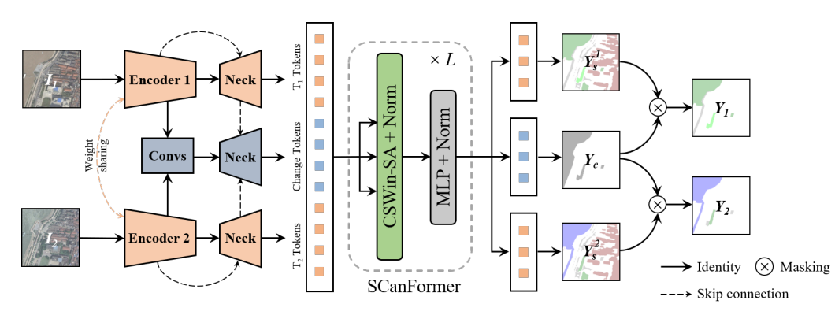
Semantic Change Detection (from-to CD) ^{[9]}
Architecture of the ScanNet (Semantic Change Network) for SCD.

Slide 18
References
Shi, W.; Zhang, M.; Zhang, R.; Chen, S.; Zhan, Z. Change detection based on artificial intelligence: State-of-the-art and challenges. Remote Sens. 2020, 12, 1688
Afaq, Y.; Manocha, A. Analysis on change detection techniques for remote sensing applications: A review. Ecol. Inform. 2021, 63, 101310.
Cheng, G.; Huang, Y.; Li, Y.; Lyu, S.; Xu, Z.; Zhao, Q.; Xiang, S. Change Detection Methods for Remote Sensing in the Last Decade: A Comprehensive Review. arXiv 2023, arXiv:2305.05813.
Bai, T.; Wang, L.; Yin, D.; Sun, K.; Chen, Y.; Li, W.; Li, D. Deep learning for change detection in remote sensing: A review. Geo-Spat. Inf. Sci. 2022, 1–27.
Caye Daudt, R.; Le Saux, B.; Boulch, A. Fully convolutional siamese networks for change detection. In Proceedings of the International Conference on Image Processing (ICIP), Athens, Greece, 7–10 October 2018; pp. 4063–4067.

Slide 19
References
Saha, S.; Shahzad, M.; Ebel, P.; Zhu, X.X. Supervised Change Detection Using Prechange Optical-SAR and Postchange SAR Data. IEEE J. Sel. Top. Appl. Earth Obs. Remote Sens. 2022, 15, 8170–8178.
Bandara, W.G.C., Patel, V.M.: A transformer-based siamese network for change detection. arXiv preprint arXiv:2201.01293 (2022)
L. Ding, H. Guo, S. Liu, L. Mou, J. Zhang, and L. Bruzzone, “Bi-temporal semantic reasoning for the semantic change detection in HR remote sensing images,” IEEE Trans. Geosci. Remote Sens., vol. 60, 2022, Art. no. 5620014.
L. Ding, J. Zhang, H. Guo, K. Zhang, B. Liu and L. Bruzzone, "Joint Spatio-Temporal Modeling for Semantic Change Detection in Remote Sensing Images," in IEEE Transactions on Geoscience and Remote Sensing, vol. 62, pp. 1-14, 2024, Art no. 5610814, doi: 10.1109/TGRS.2024.3362795.

Slide 20
Thank You

